Slide 1

A Risk Adjustment Model for Home Health Agencies

Slide 2

About Us
Elisa White
Erica Rosa
Jensen Binoji
Ted Stagner
Tim Halligan
Our mission is to find solutions to improve the deliverance of cost efficient healthcare as Medicare moves towards a value based reimbursement structure.
Notes:
ELISA

Slide 3
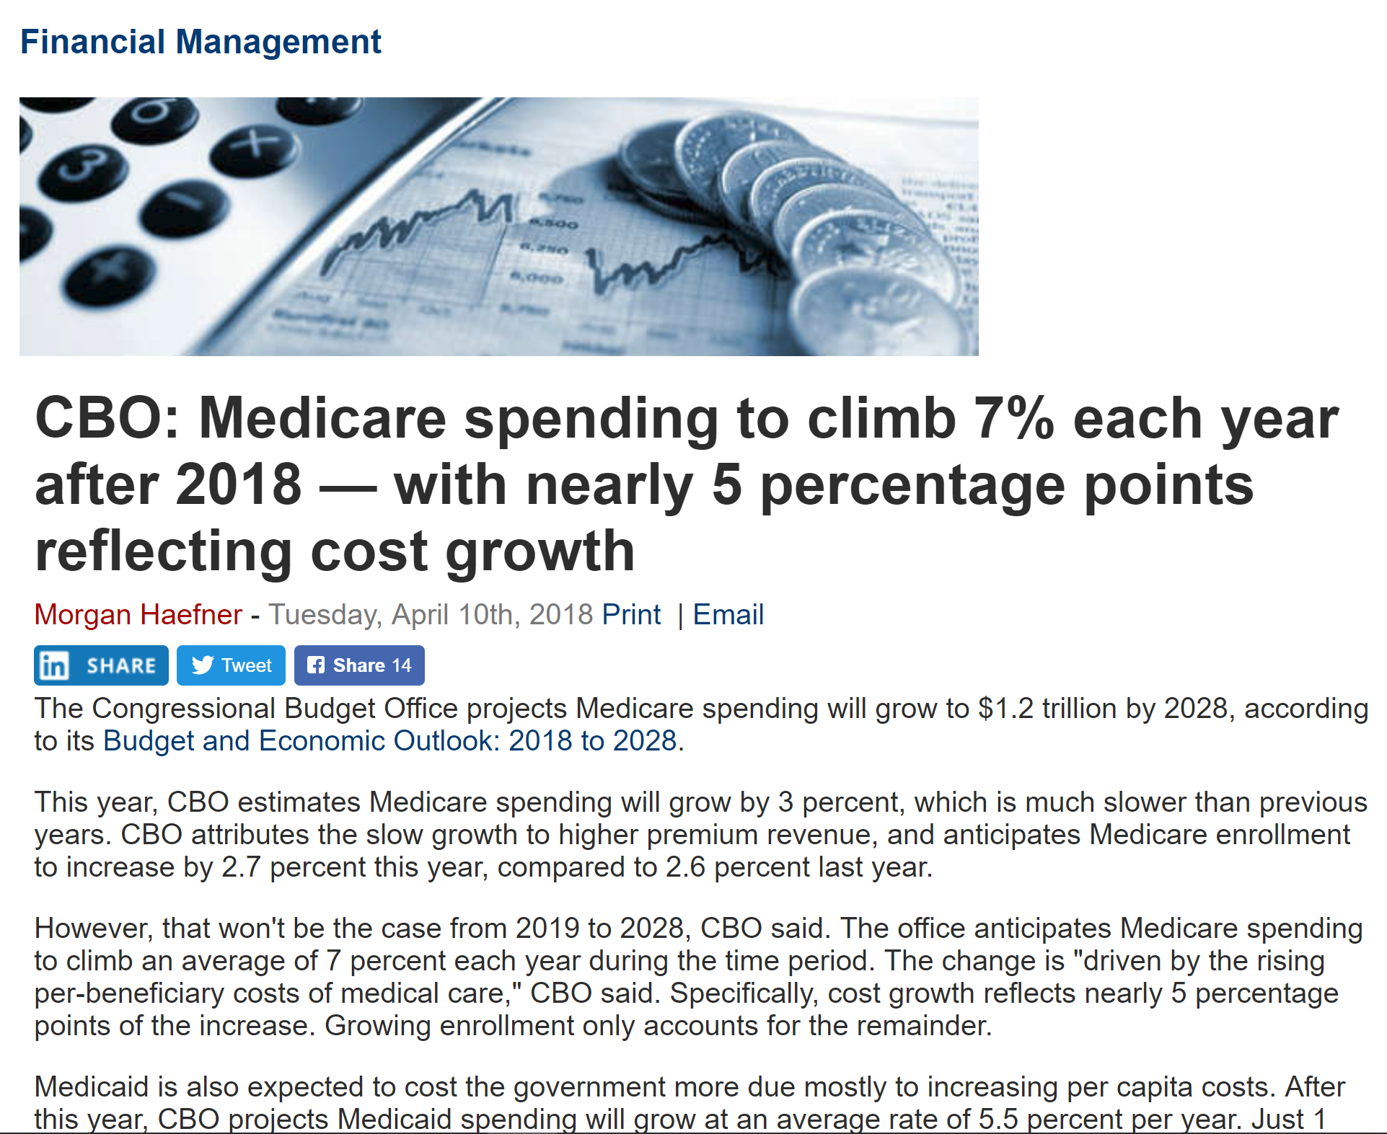
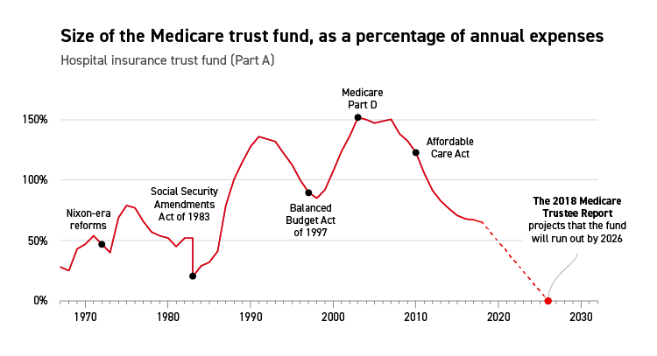
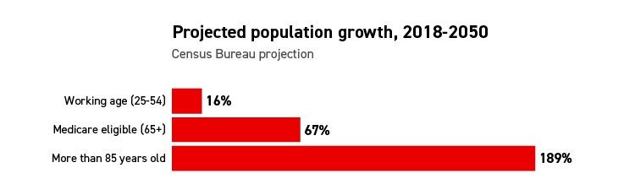
The Problem
Increasing Medicare Population
Increasing Medicare Spend
Decreasing Funding
The Medicare Population is projected to increase at a greater rate than any other demographic.
Medicare Beneficiary spending is expected to continue rising annually.
The Medicare fund is projected to be depleted by 2026.
https://www.politico.com/agenda/story/2018/09/12/medicare-baby-boomers-trust-fund-000694
Notes:
ELISA

Slide 4




Solution
Prioritize
Model
Monetize
Home Health Dataset Analysis for understanding of current population.
Create Risk Adjustment model using Home Health Dataset
Use model to recommend expenditure adjustments
Create a Risk Adjustment model for high risk beneficiary predictions to adjust reimbursement for improved cost effective care.
Notes:
ELISA

Slide 5

Dataset Preliminary Analysis
Notes:
ERICA

Slide 6

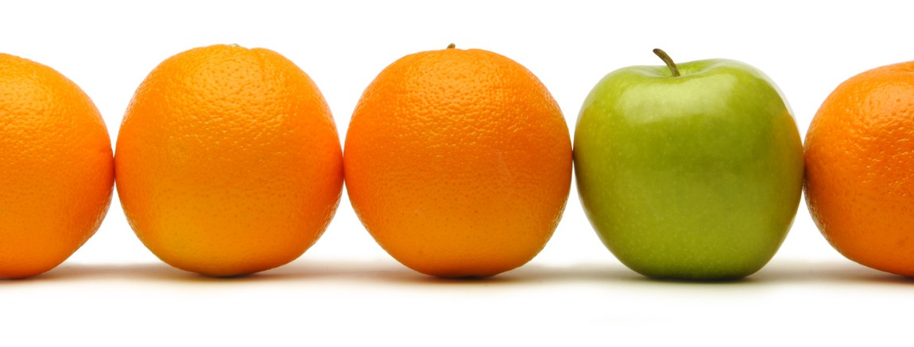
Hierarchical Condition Category (HCC) Scores
Capitation vs Pay for Performance
Risk Adjustment Mechanisms
CMS HCC Scores
Specialty-specific risk adjustment model
Notes:
ERICA
In some payment models, payers reimburse providers a flat rate per patient (capitation), and in others, payers assess penalties or provide bonuses based on cost or quality of care outcomes (pay-for-performance).
In such models, risk adjustment is important. Risk adjustment mechanisms predict whether a given patient, or group of patients, is likely to be more or less costly to treat than the average population and provides a way to adjust payment accordingly. Risk adjustment compensates health plans and providers for treating sicker patients, and reduces their incentives to select healthy or less costly patients. Risk adjustment mechanisms predict whether a given patient, or group of patients, is likely to be more or less costly to treat than the average population and provides a way to adjust payment accordingly.
The Centers for Medicare & Medicaid Services (CMS) risk adjustment model is a hierarchical condition category (HCC) score. Use of the HCC model is expanding, and there is concern over whether it functions as intended. If CMS-HCC risk scores do not accurately reflect patient health status because of factors such as coding practices or capacity, then payments may not be associated with the true cost of treatment.
Additionally, treatment paths and associated costs can vary greatly within patient populations of a specific provider type. We developed a model focused on home health agencies, to explore this concept and try to discover additional patterns that can inform initiatives to reduce burdensome healthcare spending.

Slide 7
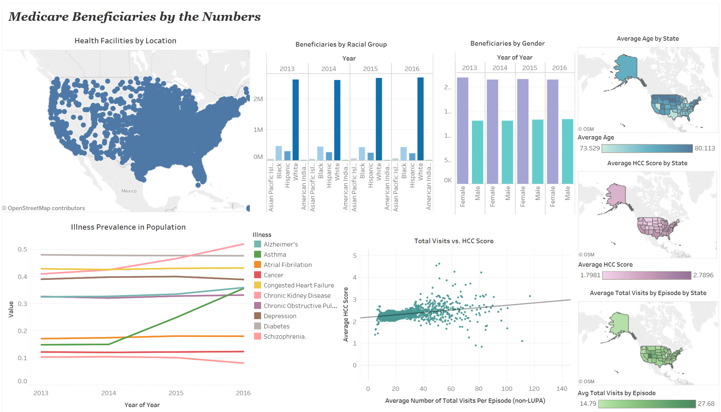
Notes:
ELISA

Slide 8

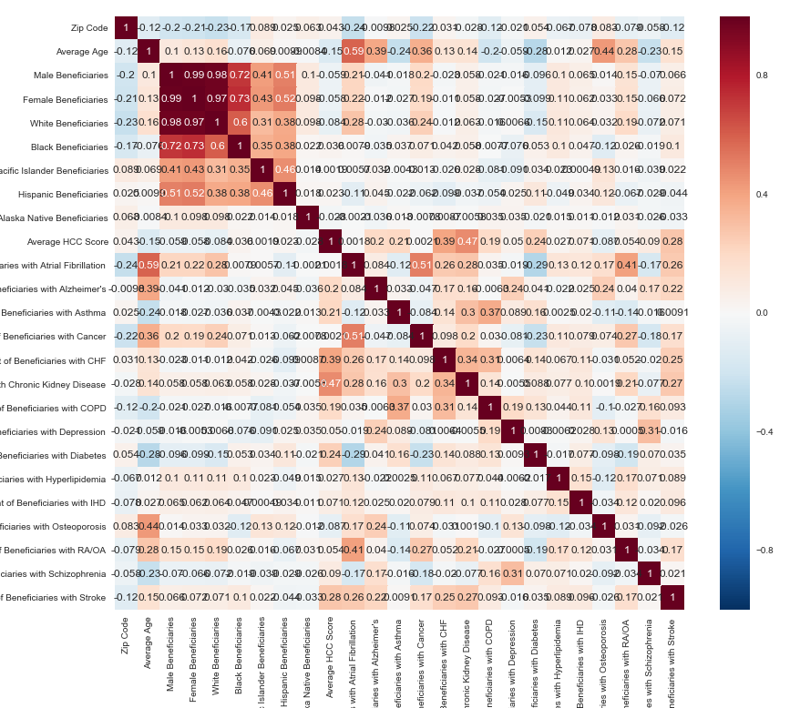
The Model
Notes:
TRANSITION

Slide 9
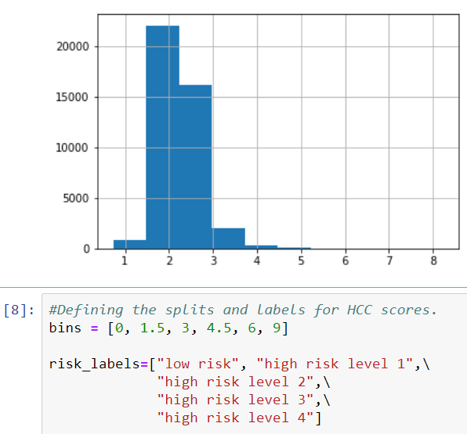
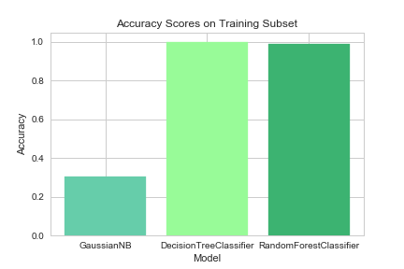
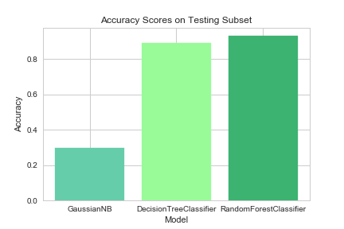
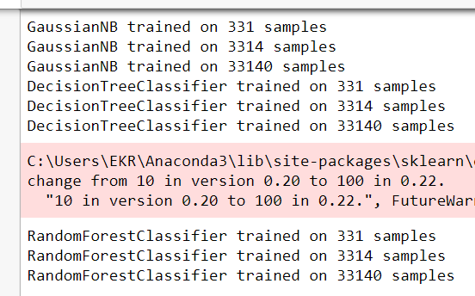
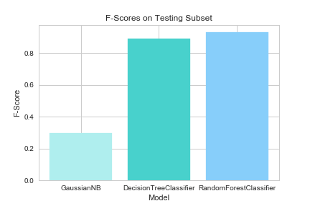
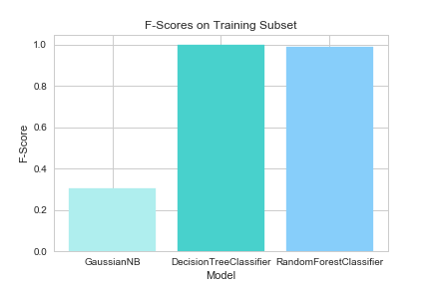
Gaussian
Decision Tree
Random Forest Classifier
Notes:
ERICA
One of the big problems in machine learning is overfitting, but most of the time this won’t happen that easy to a random forest classifier. That’s because if there are enough trees in the forest, the classifier won’t overfit the model.

Slide 10
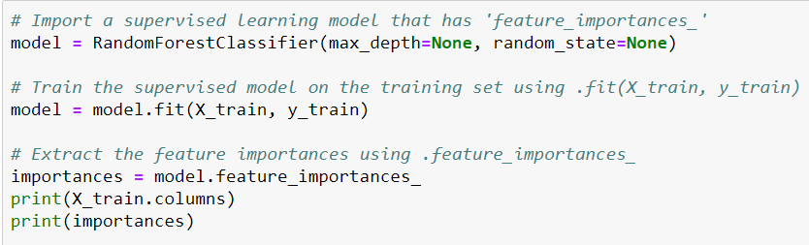
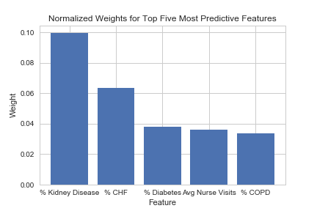
Feature
Importances
Notes:
ERICA
Random Forest is a predictive modeling tool and not a descriptive tool. That means, if you are looking for a description of the relationships in your data, other approaches would be preferred.

Slide 11
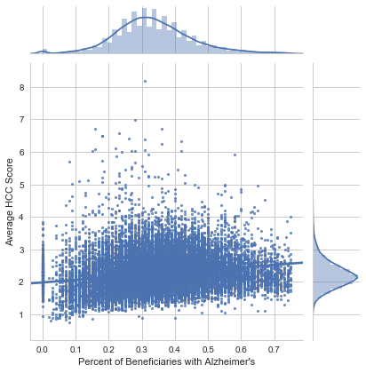
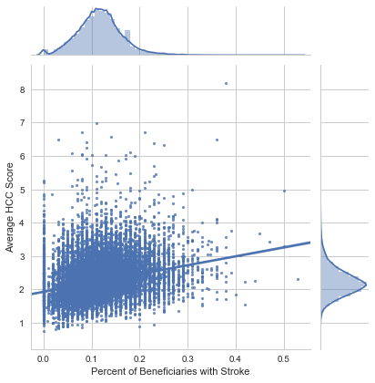
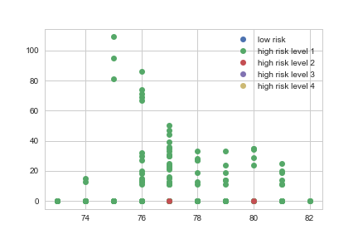
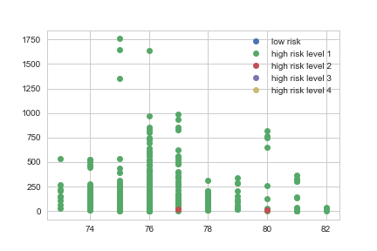
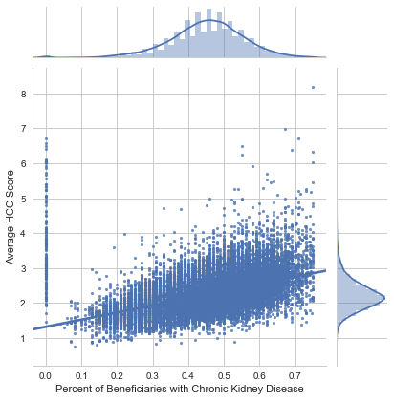
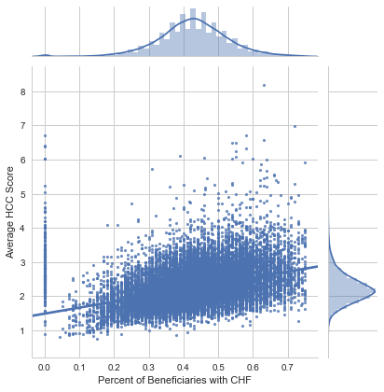
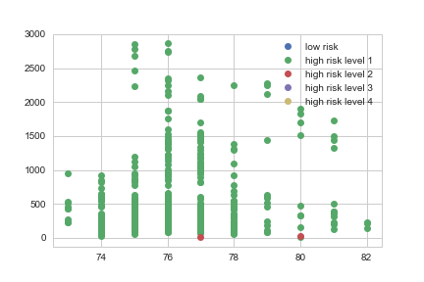
Alzheimer’s vs HCC Score
Stroke vs HCC Score
Black Beneficiaries by Risk and Age
White Beneficiaries by Risk and Age
Chronic Kidney Disease vs HCC Score
Congested Heart Failure vs HCC Score
Asian Beneficiaries by Risk and Age
Notes:
ERICA
Additional descriptive exploration for potential relationships between features

Slide 12
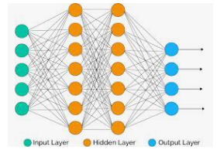
Deep Learning-Categorical
Hierarchical Condition Categories (HCC)
Originally, 2 HCC categories were created with one of them for values below 1.08
and one category for values above 1.08.
Think of HCC as a cost/illness indicator.
A higher number is a higher cost and illness.
Below 1.08 was called low risk
Above 1.08 was called high risk
Our data was somewhat ambiguously described and labeled. The data was labeled as non-LIPA
or Non- Low Utilization Payment Adjustment Data implying the data was concerned with higher healthcare utilization or higher hcc.
This seemed to be confirmed by the data:
42,000 rows had HCCs of 1.08 and above
Only 50 rows had HCCs of below 1.08
39 Features input dimension
2x10 hidden layers
2 unit output layer via softmax
Loss calculated via categorical_crossentropy
Notes:
TED

Slide 13
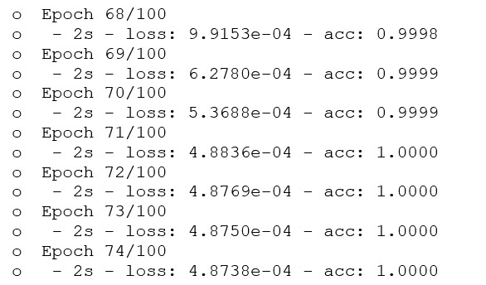
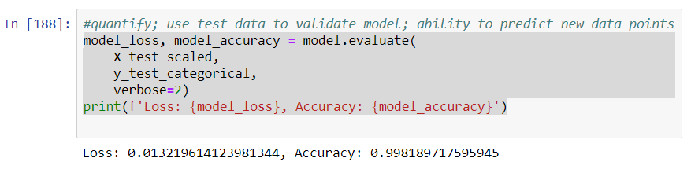
Deep Learning-Categorical
This might explain:
An accuracy near 1
And small losses
For both the training and test data sets.
Notes:
TED

Slide 14
Deep Learning-Regression
In addition to evaluating the data categorically with deep learning,
the data was evaluated with Regression and Mean Squared Error(MSE) via deep learning
1 input dimension
2x6 hidden layers
1 unit output layer via ‘linear’
Loss calculated via Mean Squared Error(MSE)
Notes:
TED

Slide 15
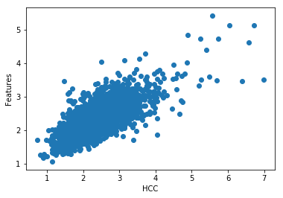
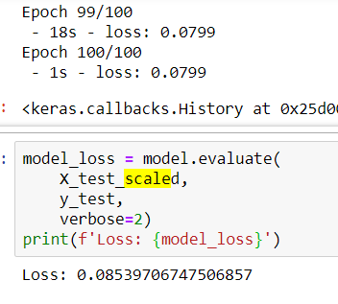
Deep Learning-Regression
Again the test train had a lower loss of around 0.08
Since this was regression we did not have an accuracy number
The prediction was plotted:
import matplotlib.pyplot as plt
%matplotlib inline
plt.scatter(y_test,model.predict(X_test_scaled))
plt.xlabel('HCC')
plt.ylabel('Features')
Notes:
TED

Slide 16
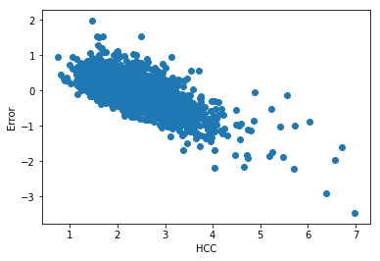
Deep Learning-Regression
Additionally, the error was checked in regards to HCC and found that the error increased with higher hcc scores:
err = model.predict(X_test_scaled)[:,0] - y_test
plt.scatter(y_test, err)
plt.ylabel('Error')
plt.xlabel('HCC')
Notes:
TED

Slide 17
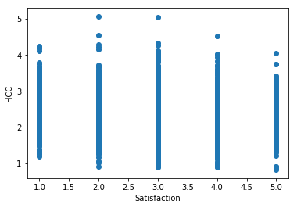
HCC vs Satisfaction
Hypothesis: with higher hcc you may see lower satisfaction
Raw data
The raw data does seem to suggest this as you see less 4 and 5 satisfaction ratings with a 4 and 5 hcc.
Notes:
TED

Slide 18
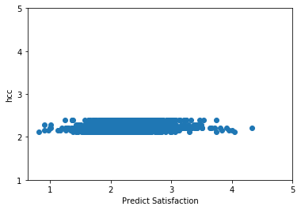
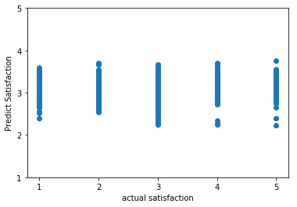
HCC vs Satisfaction
Deep Learning Regression utilized with MSE
Loss for train and test around 0.12
2x6 hidden layer
1input
1 output
Notes:
TED

Slide 19
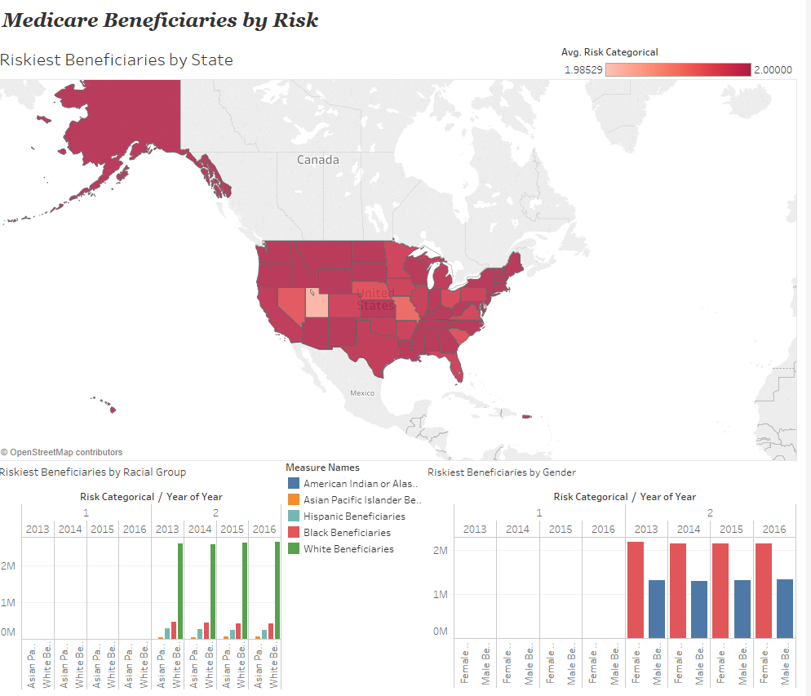
Notes:
ELISA

Slide 20

Readmission Rates Analysis on Dialysis
Notes:
JENSEN

Slide 21
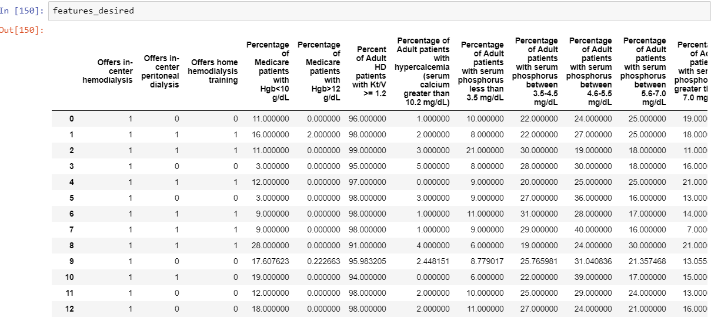
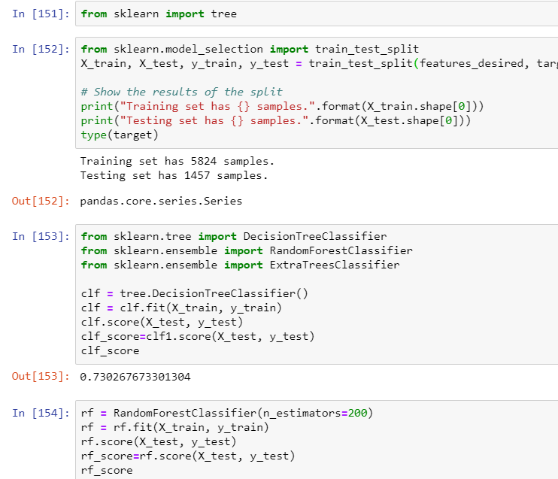
Conducted Machine Learning on Dialysis Data
Features for comparison
Notes:
JENSEN

Slide 22
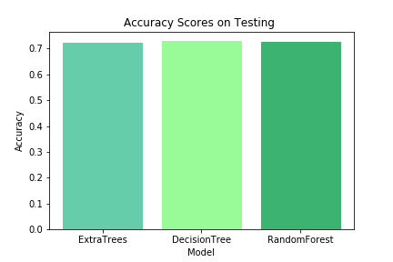
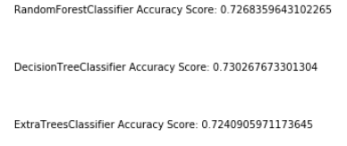
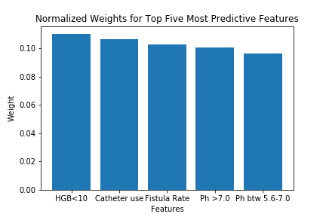
Accuracy tests run on all models indicate almost similar scores HGB counts ,stands as one of the significant features contributing to high readmission rates .
Notes:
JENSEN

Slide 23

Summary
Medicare beneficiaries at home health facilities have consistent risk levels, with a few outliers.
Facilities with higher HCC scores have higher populations of chronic illnesses and should require additional funding for managing these populations.
Consider alternative methods of treatment for low risk beneficiaries at home health facilities.

Slide 24
Thank You Questions?

